Slide 1

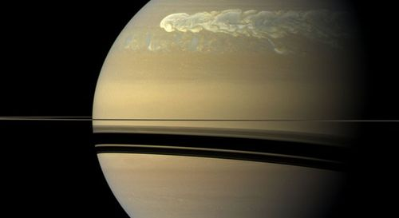
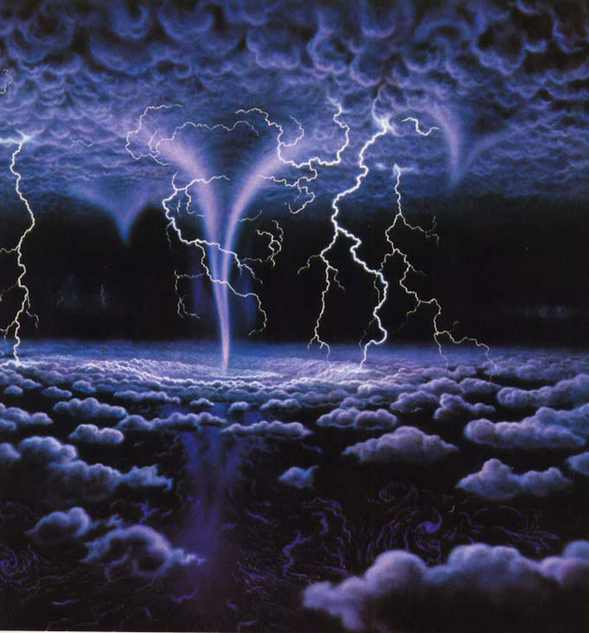
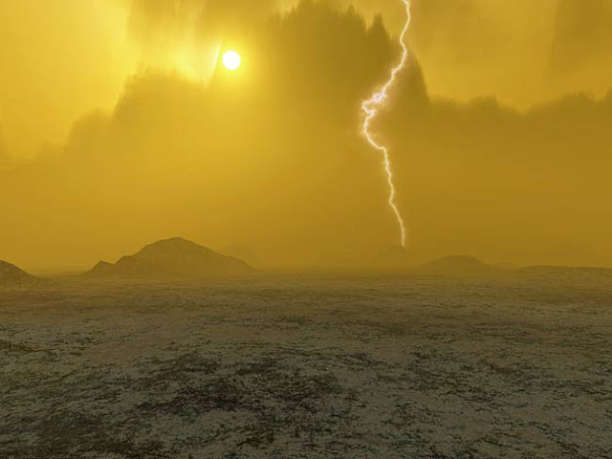

Slide 2
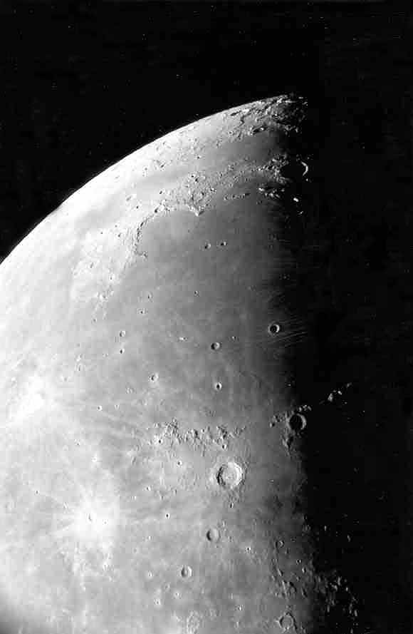
Moon maria as seen through the telescope.
Photo by Jim Fullerton

Slide 3
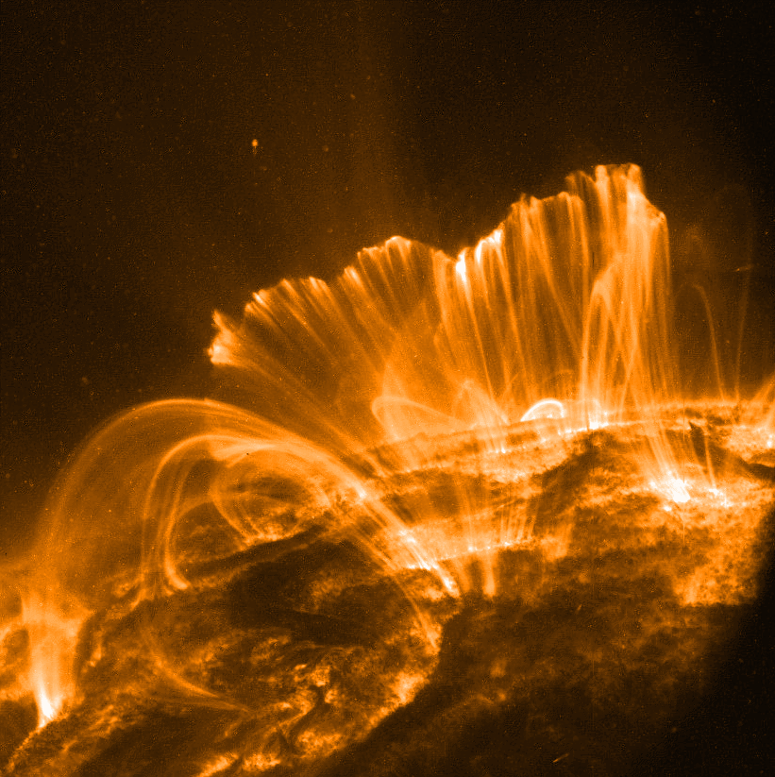
Forecast
We are expecting a solar flare today which will bring on a proton particle storm.

Slide 4
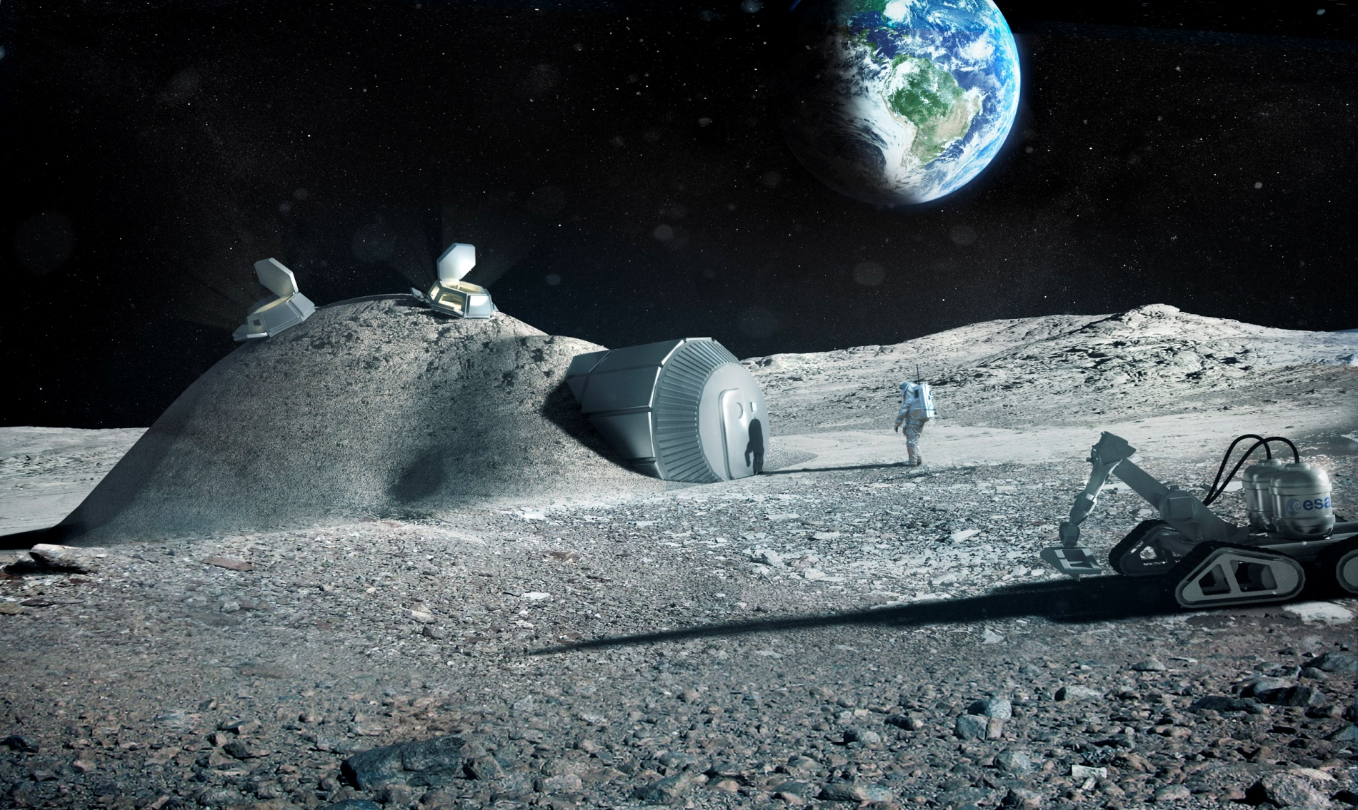
Forecast
Please take extreme precautions until the solar proton storm clears by remaining inside or underground, shielded by at least 2 ft. of lunar rock.

Slide 5
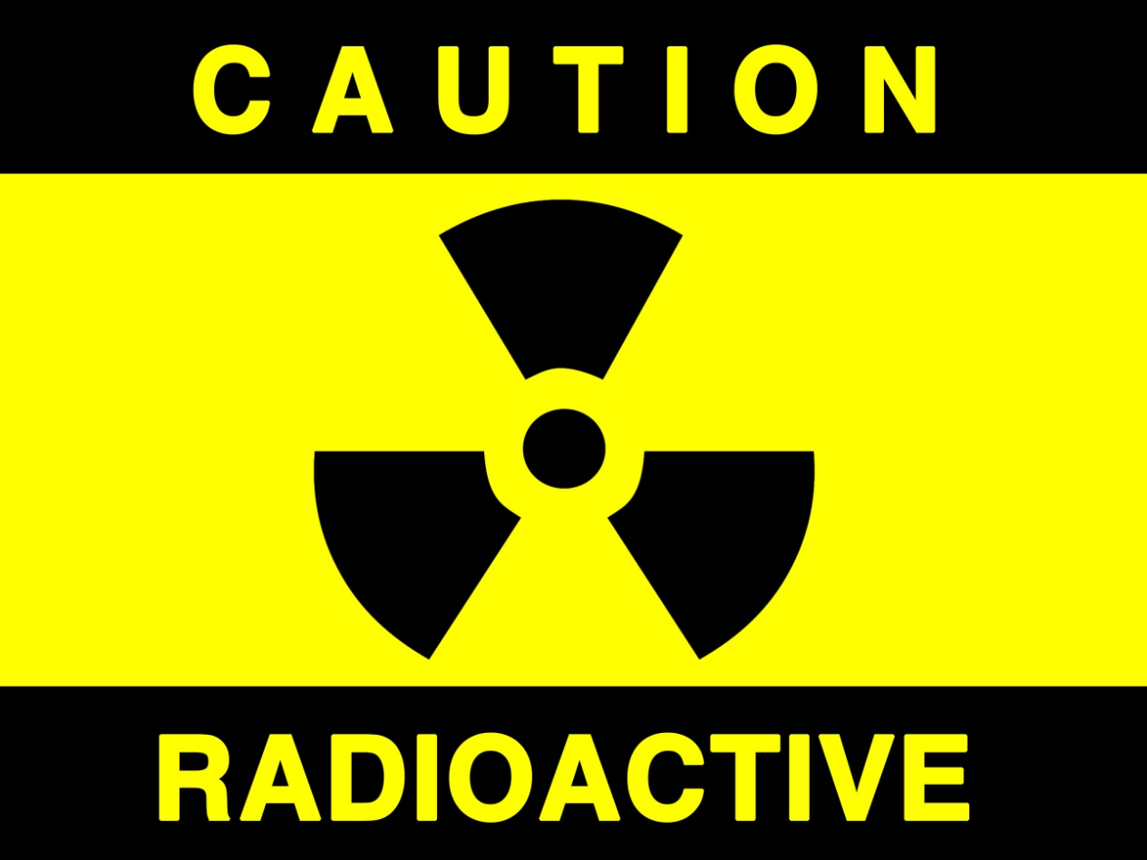
Forecast
Remember, in just a few hours, these storms can deliver much more radiation to a human than the ANNUAL limit.

Slide 6
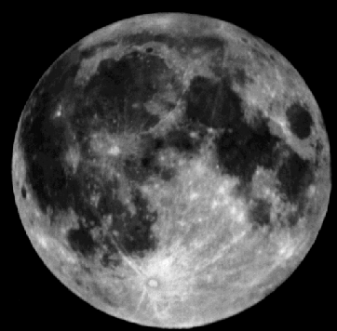
The maria (maré) are the smooth dark areas on the surface of the Moon.
Maré
Highlands

Slide 7
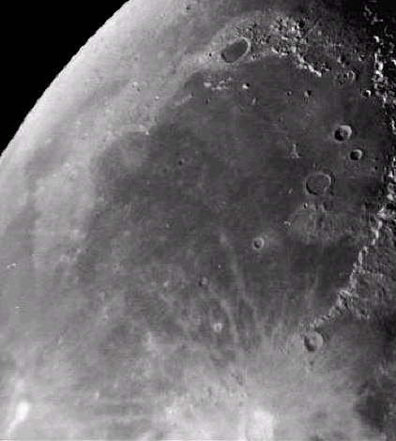
The maria were formed about 3.5 – 4 billion years ago.
Mare Imbrium
Lava flowed through cracks in the lunar surface and filled in low laying areas.

Slide 8
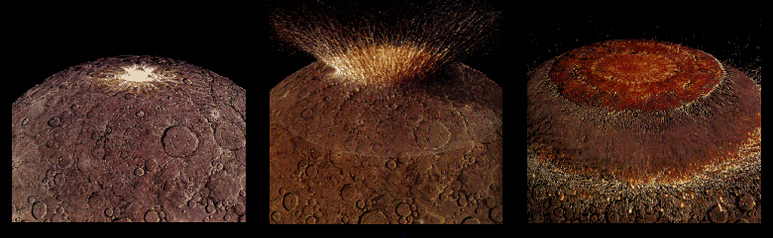
Four billion years ago the impact of a large asteroid forms a huge multi-ringed basin which thinned and fractured the lunar crust.

Slide 9
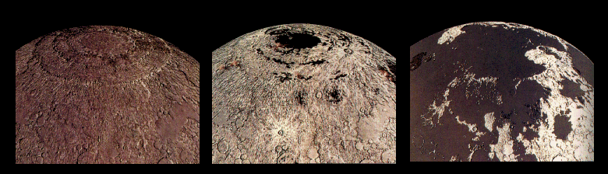
Fluid lavas from beneath the moon’s crust erupt and flood across the low regions of the lunar surface – covering many craters.

Slide 10
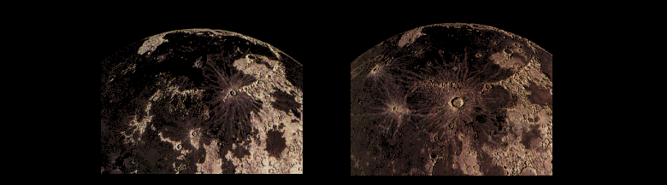
Less than a billion years after they began, the lavas cease erupting on the Moon. Occasional craters form on top of the maria.

Slide 11
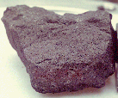
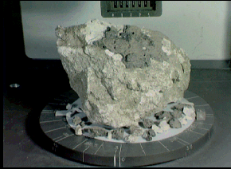
Lunar rock samples from the moon’s maria are dark colored rocks.
Samples from the highland regions are much lighter in color.

Slide 12
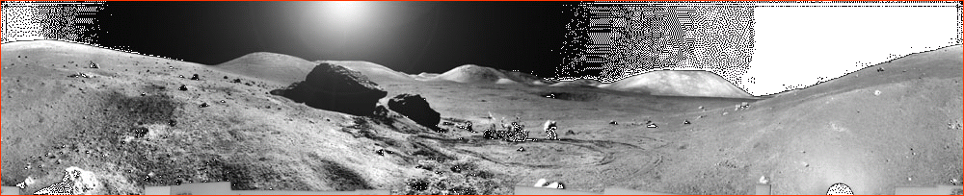
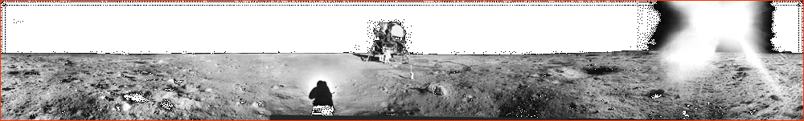
One of these shows the lunar surface from a mare and the other, the highlands.
Can you tell which is which?

Slide 13
The highlands are rugged.
The mare are smooth & flat.

